Slide 1
PRESENTATION ON BIG DATA PROJECT
Degree Program : Bachelor of Technology(B.TECH)
Specialization : Computer science/Data Analytics /Big Data
Internship Period : 1 month
Internship Location : DINGIR
Internship mode : online

Slide 2
PROJECT TITLE
State-UT-wise_Accidents_Classified_according_to_Age_of_
impacting_Vehicles_during_2017 Analysis Using Databricks.
PROJECT OVERVIEW
The assignment will focus on using Databricks,DBFS(Databricks File System),PySpark, and Spark SQL for dataIngestion,processing,analysis, and visualization.
PROJECT OBJECTIVE
The objective of this assignment is to analyze
the number of people affected by Vehicles Accident during 2017.
Creating Blob Storage Folder in Azure
and Connecting them with Azure DataBricks

Slide 3
INTRODUCTION
A data set is a structured collection of data points related to a particular subject. A collection of related data sets is called a database.
Data sets can be tabular or non-tabular. Tabular data sets contain structured data that is organized by rows and columns. Non-tabular data sets contain unstructured data contained by brackets.
DATASET
The dataset contains information on the
number of people affected by Vehicles
Accident during 2017.

Slide 4
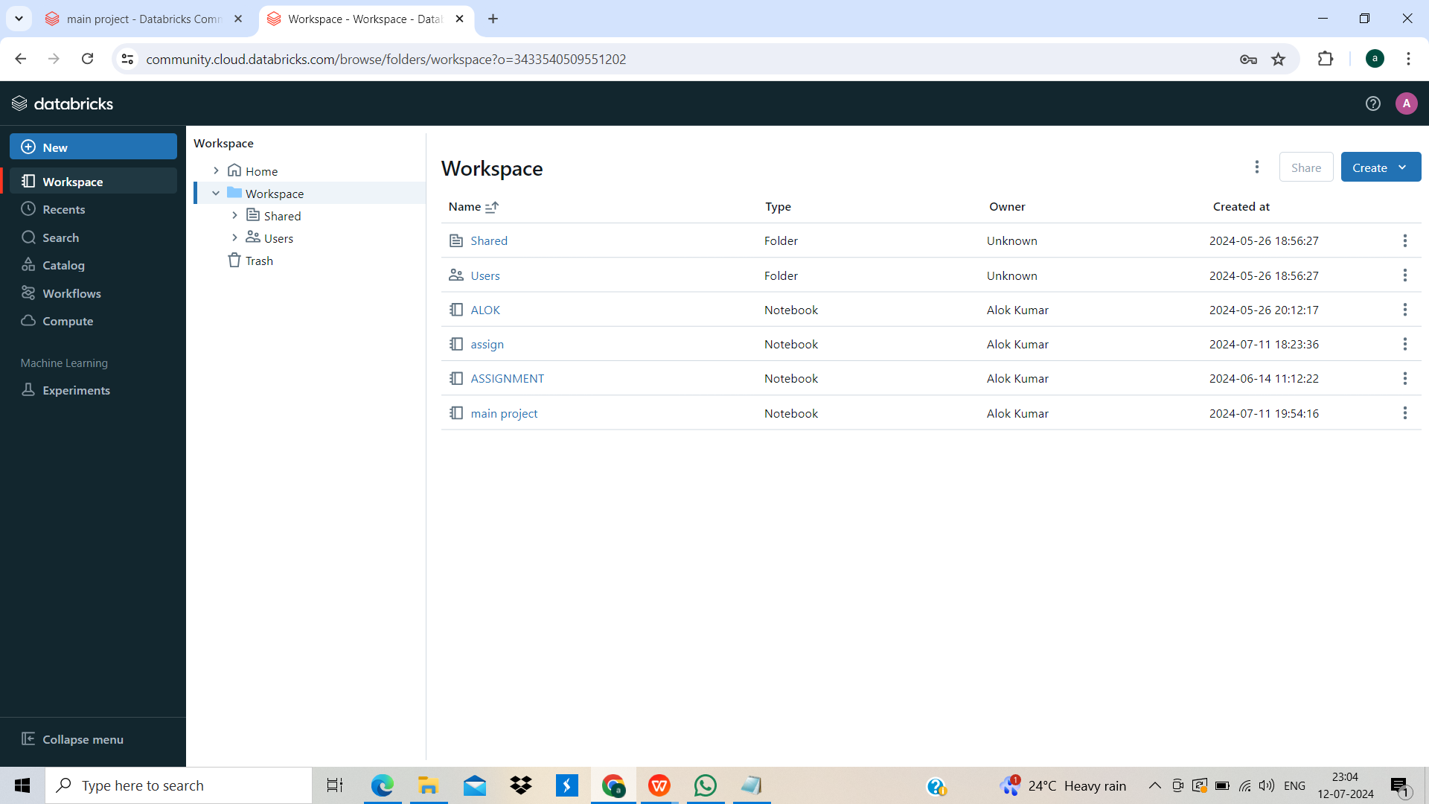
PART 1
We log into Community Edition Databricks.
Set up Databricks Workspace.

Slide 5
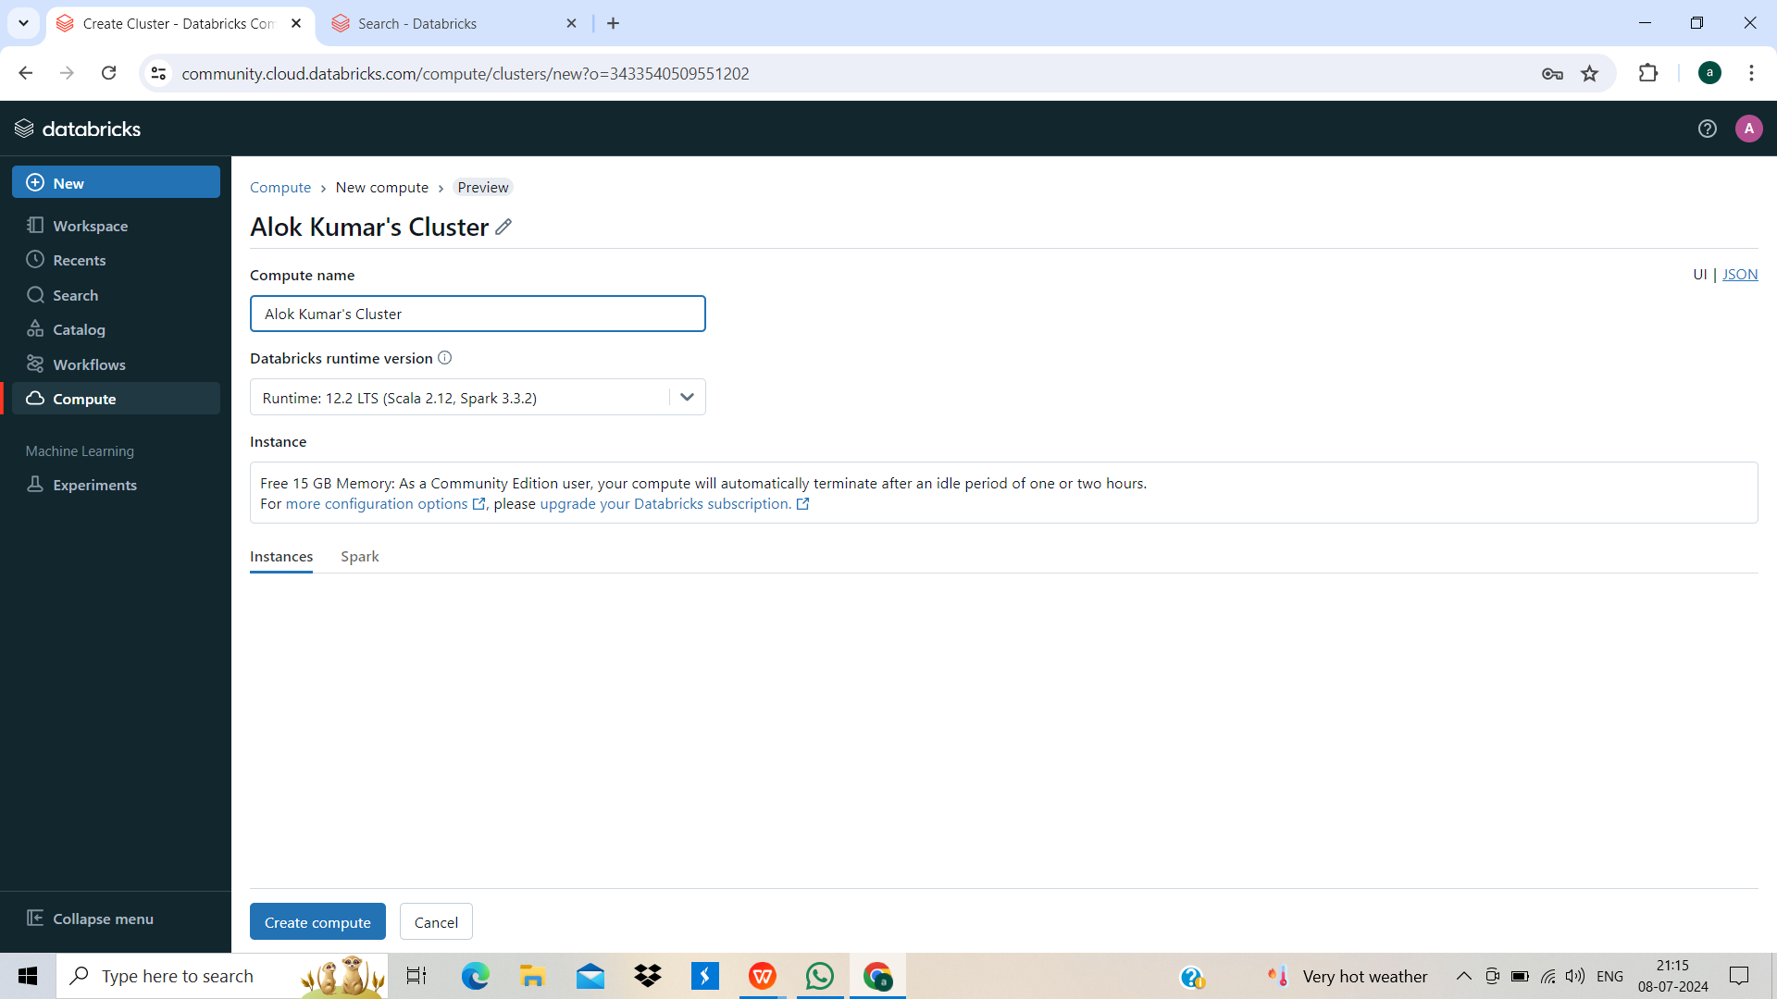
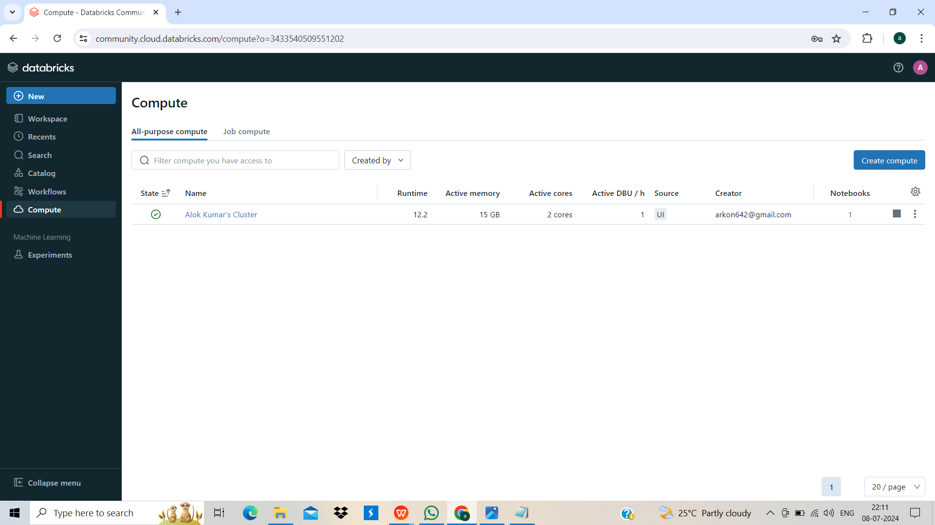
Creating Cluster

Slide 6
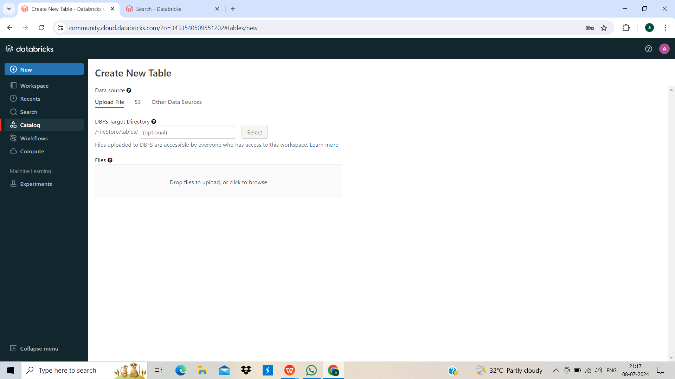
Upload the Dataset to Databricks File System(DBFS) via Catalog.

Slide 7
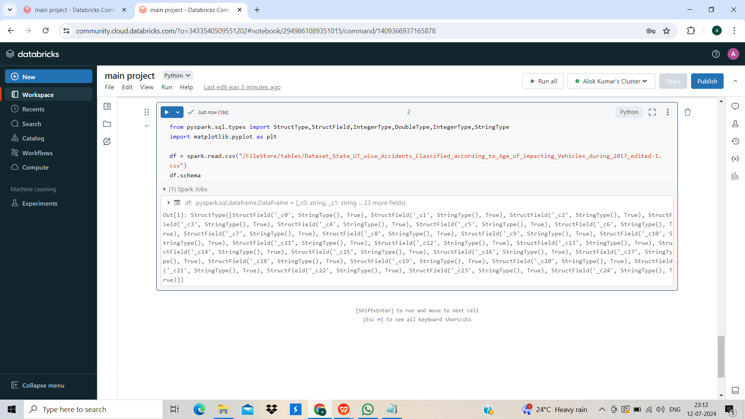
Show the Schema of the dataFrame and copy it ,to do the necessary changes.

Slide 8
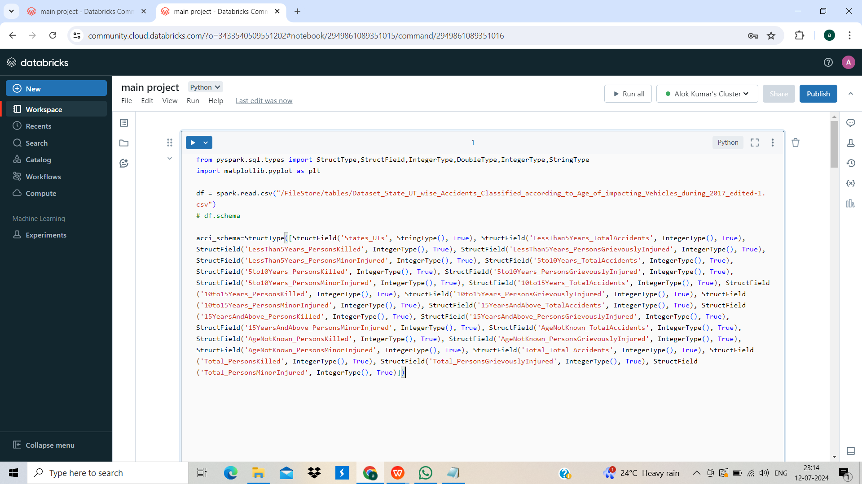
Data Cleaning and Transforamation

Slide 9
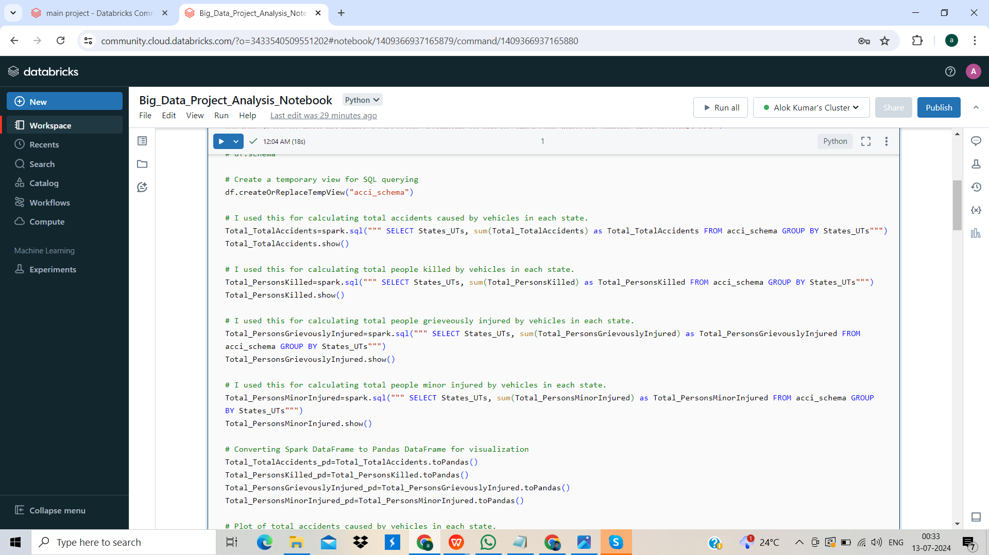
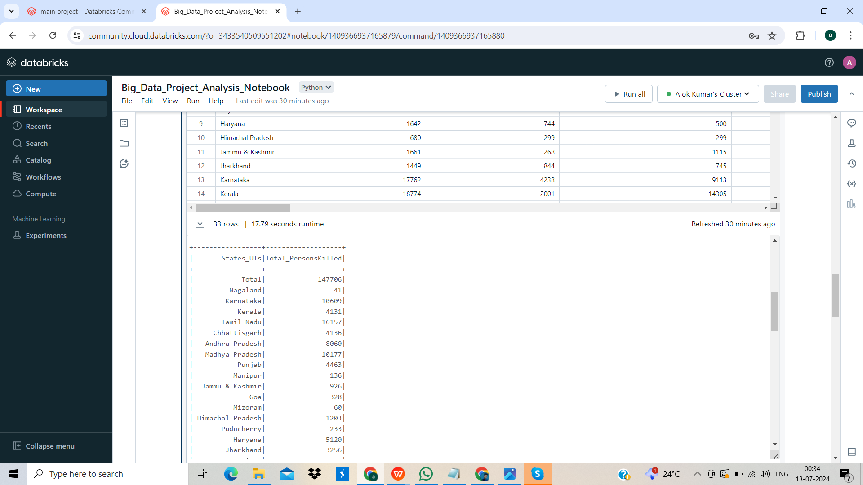
Data Analysis using Spark SQL

Slide 10
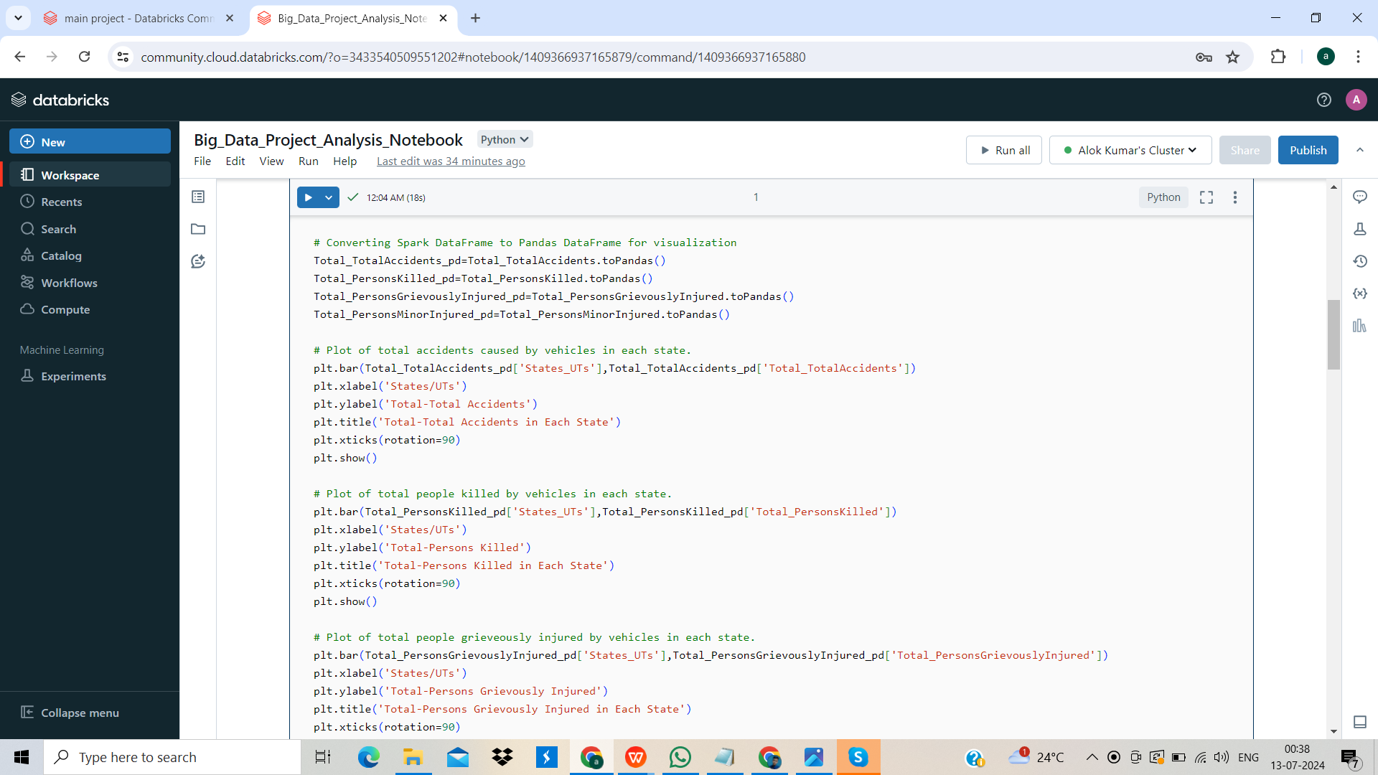
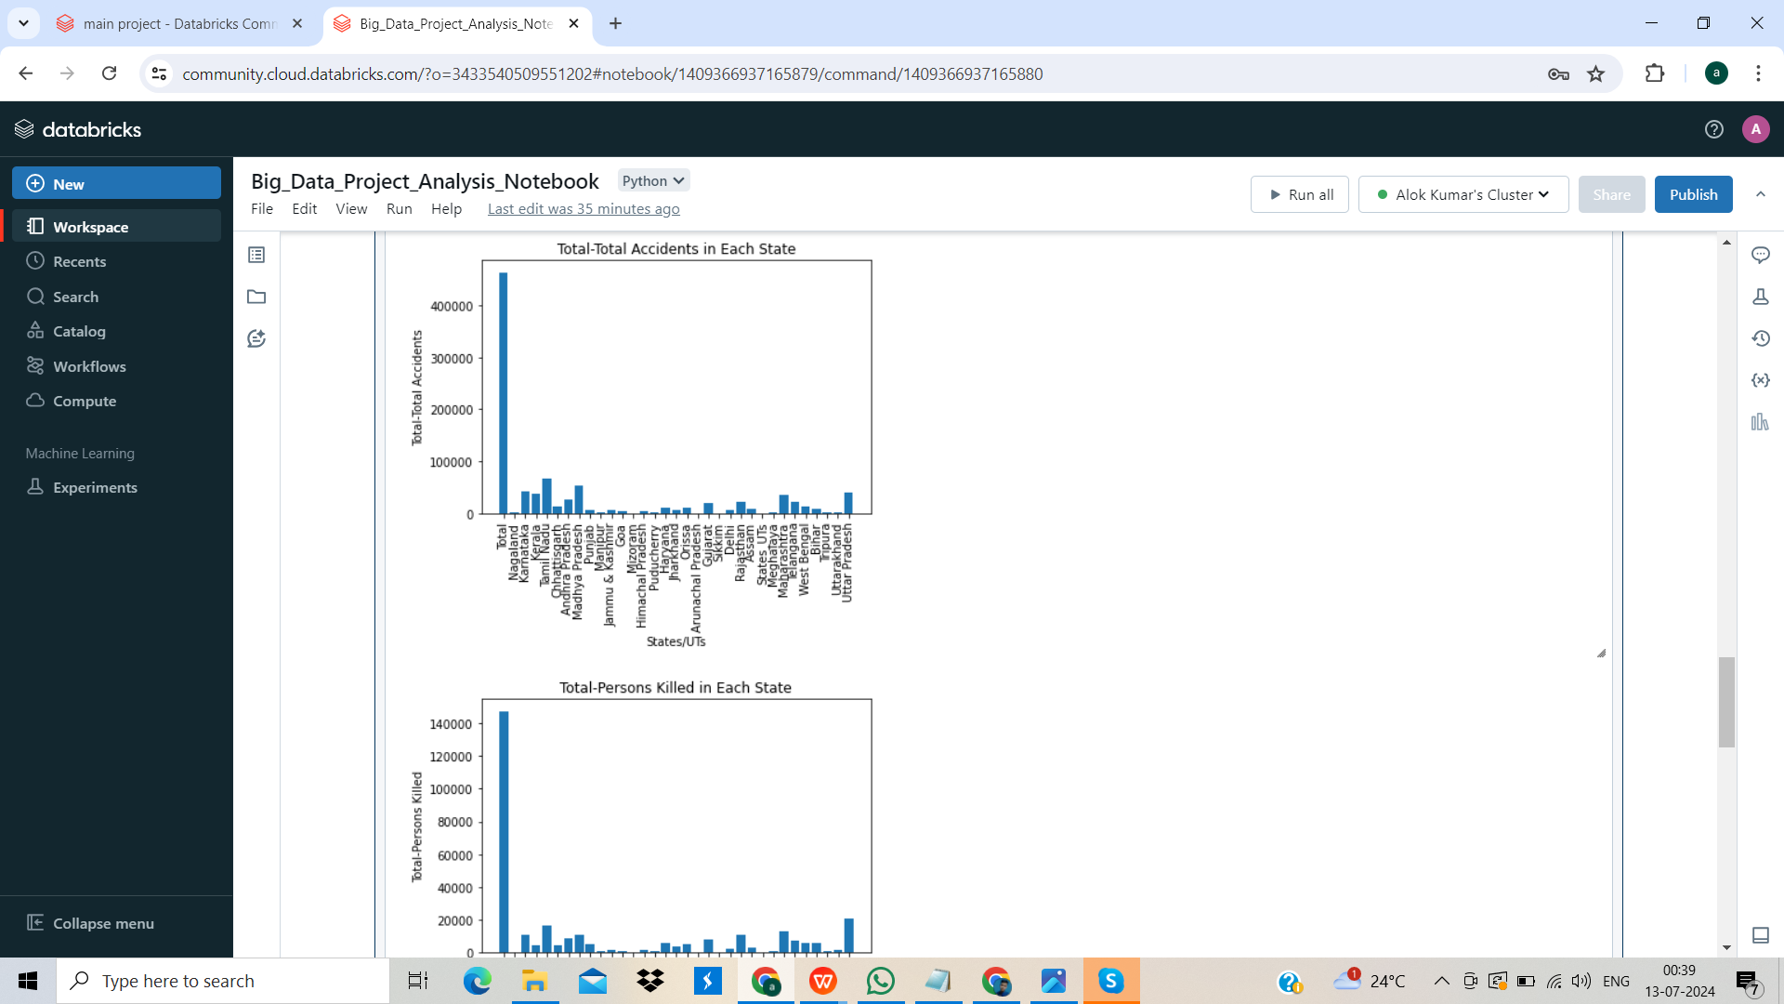
Convert Spark DataFrame to Pandas DataFrame for Data Visualization

Slide 11
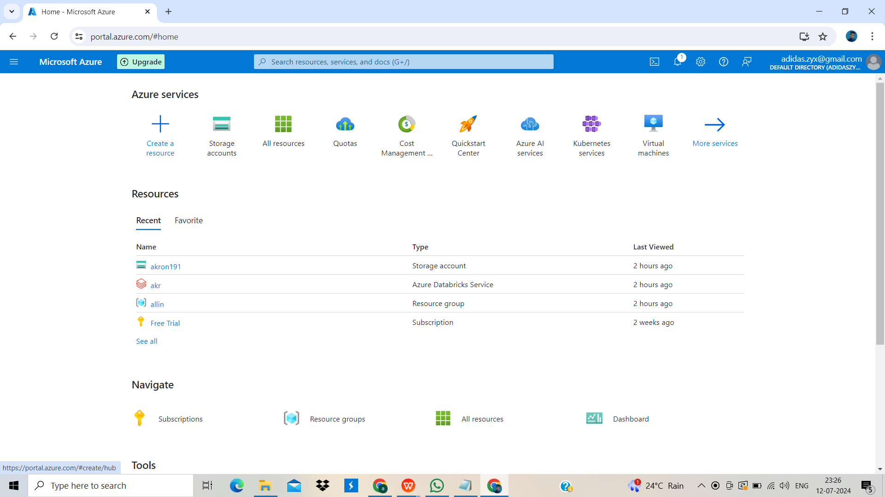
PART 2
Creating Blob Storage Folders in Azure

Slide 12
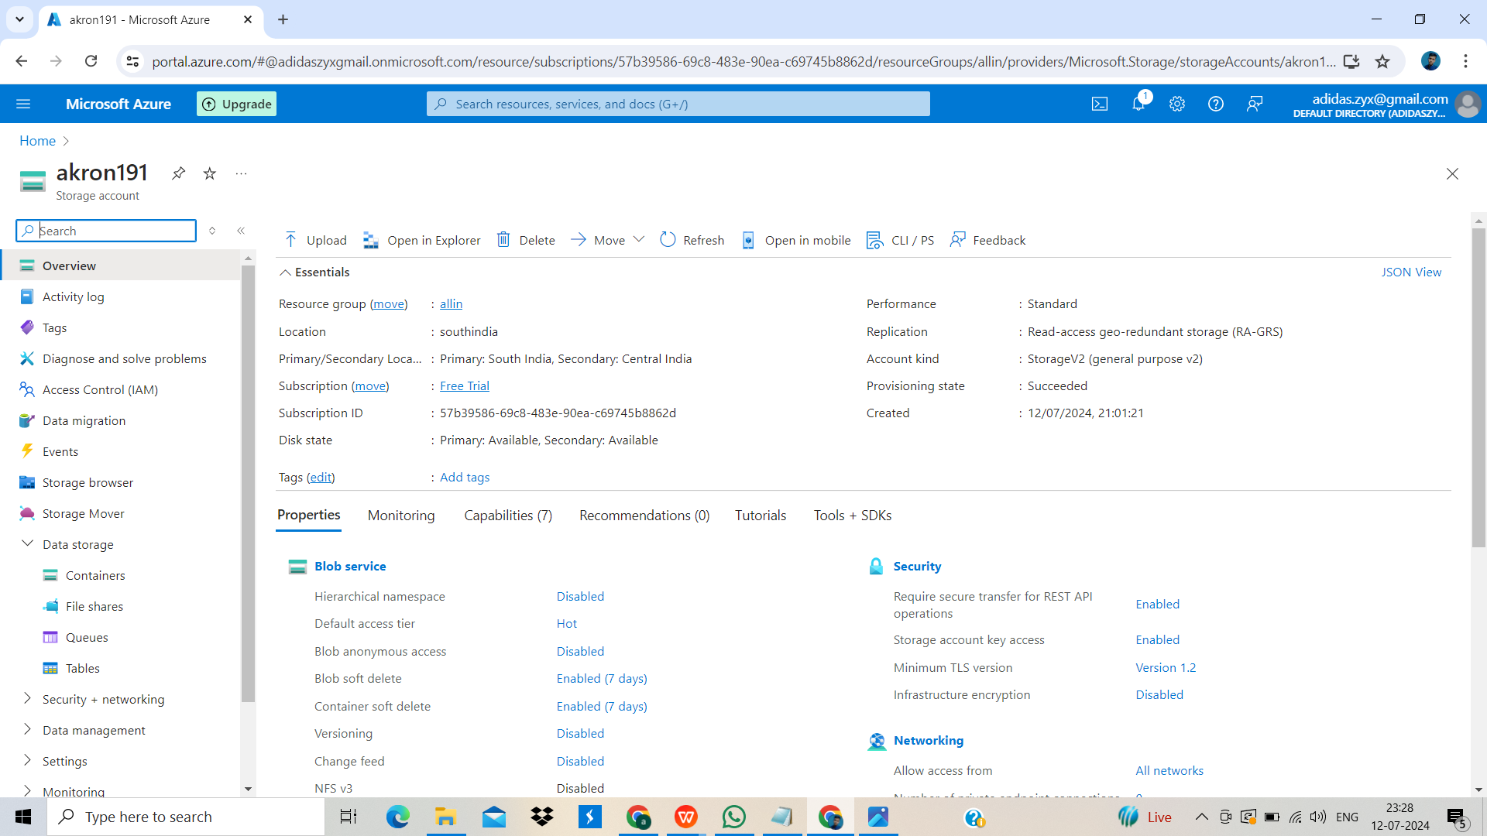
Creating Storage Account and Resource Group

Slide 13
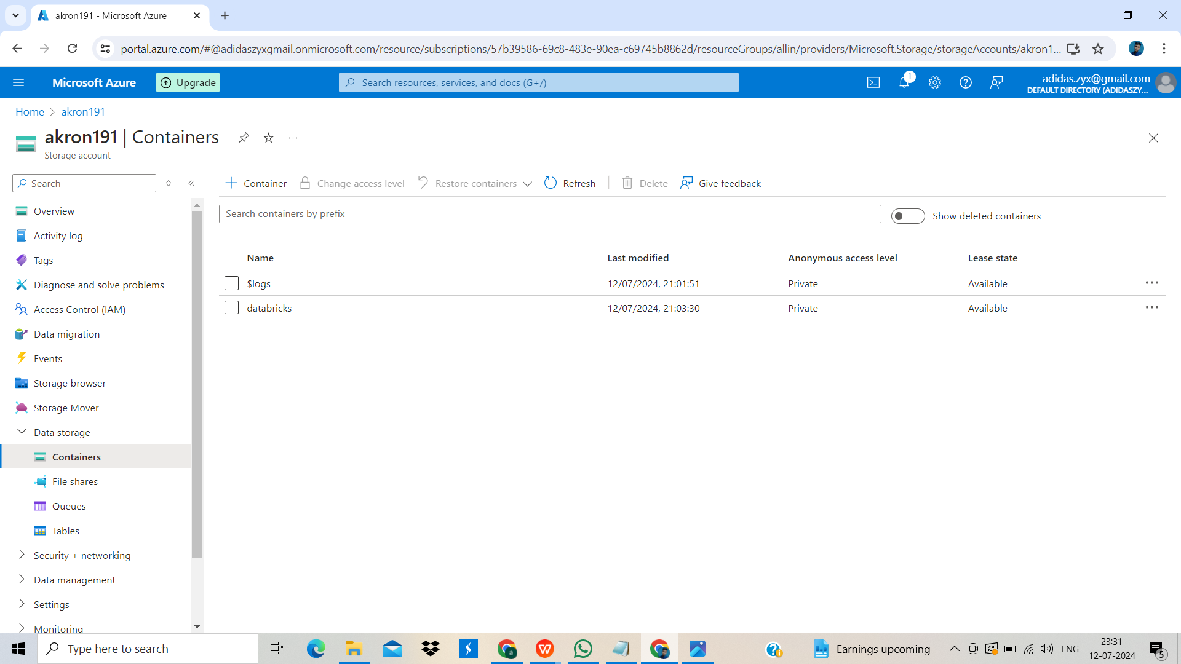
Creating Container and Folder to upload Dataset.

Slide 14
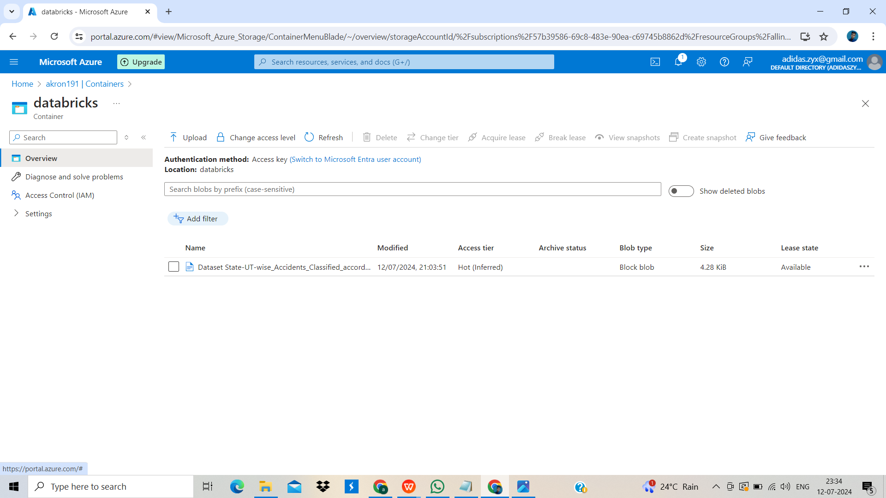
Uploading the dataset

Slide 15
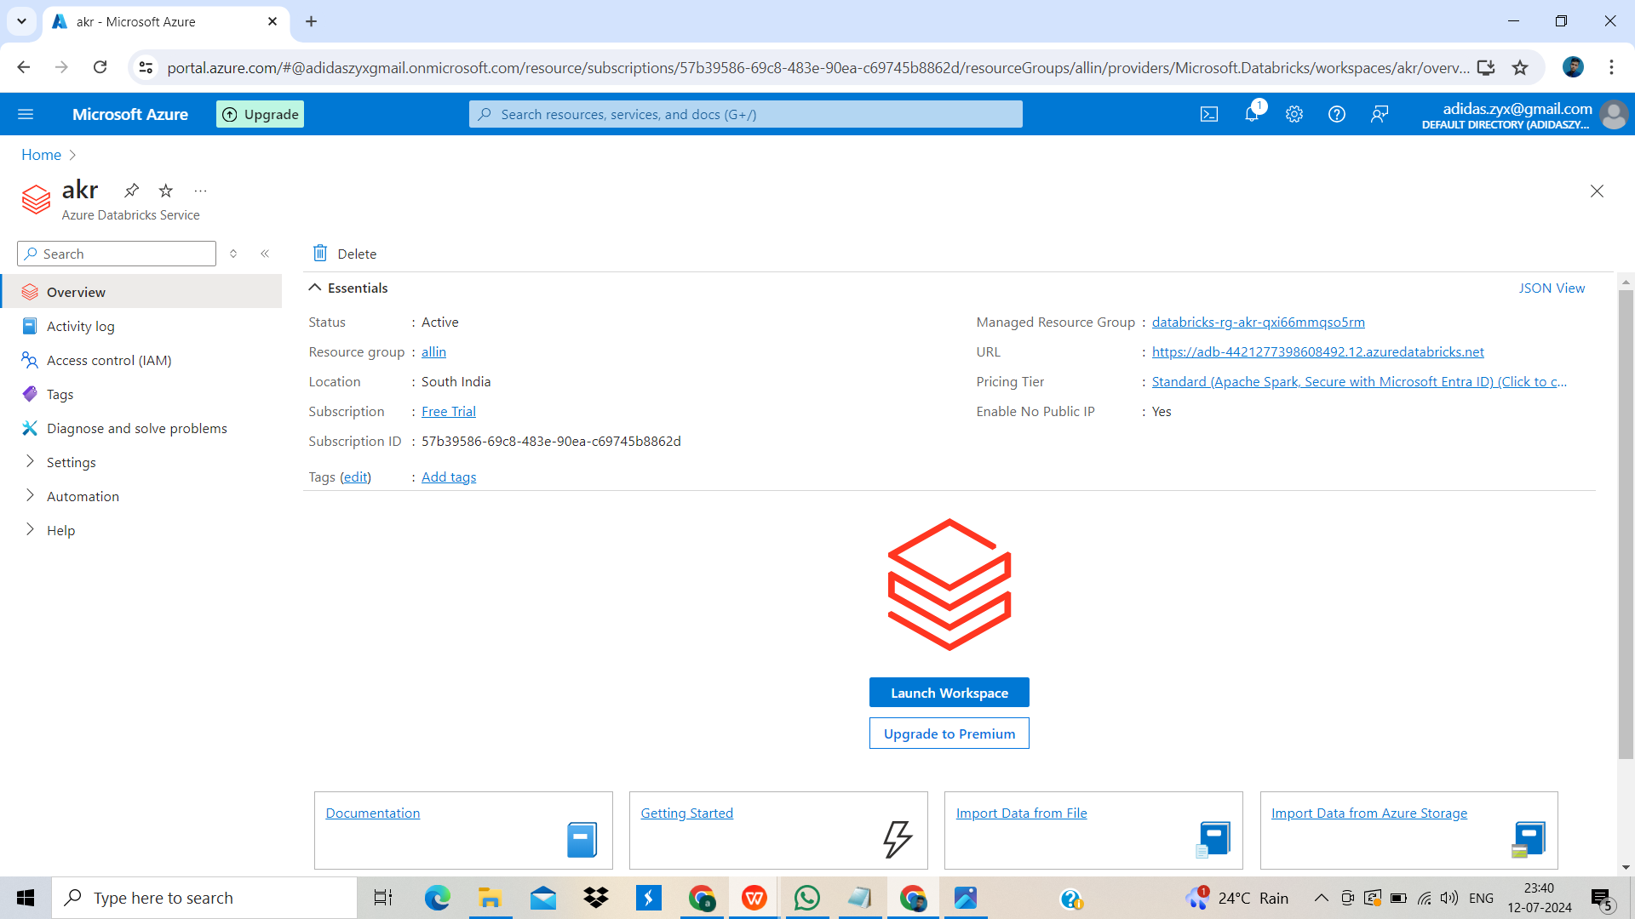
Launching Azure Databricks

Slide 16
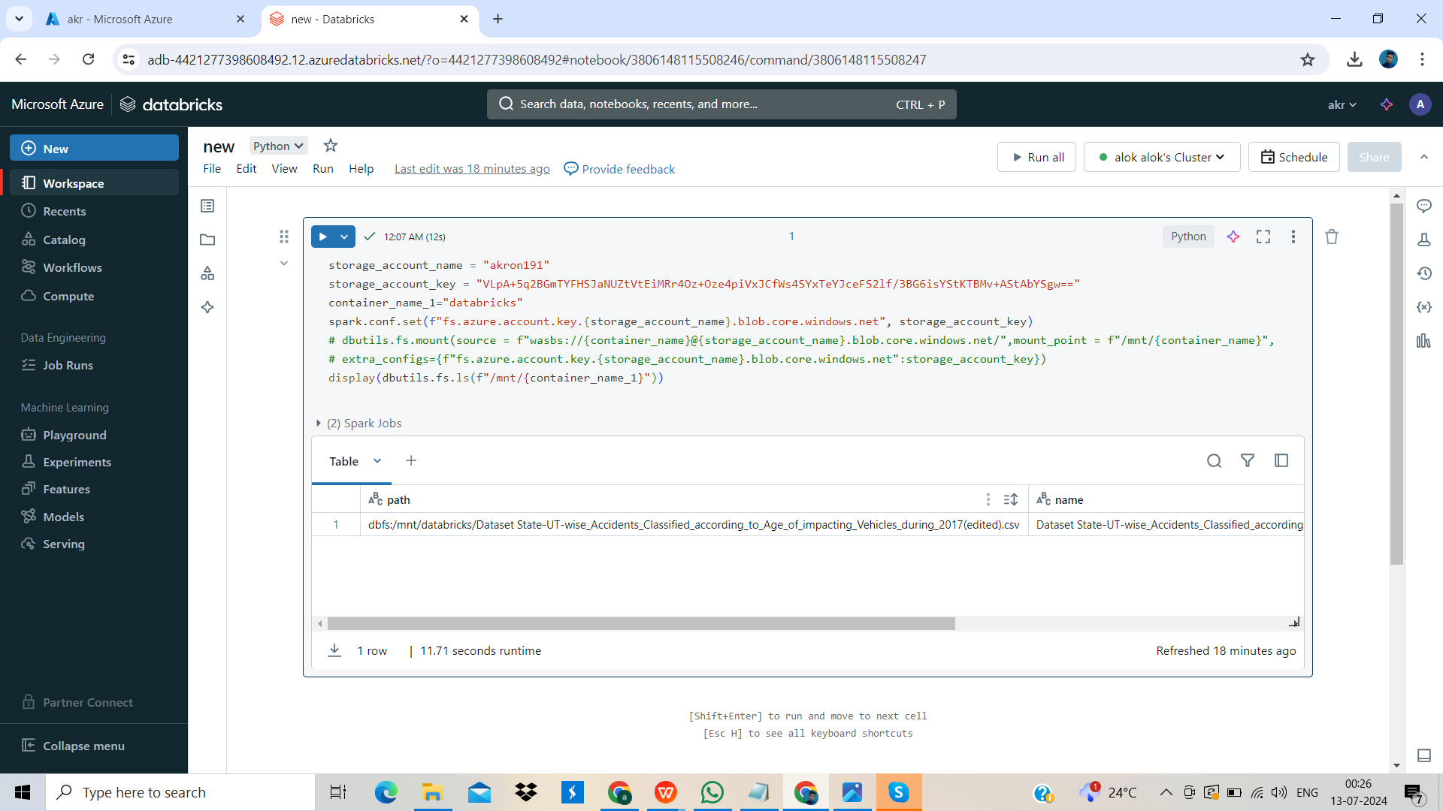
Mounting the Blob Storage to Databricks and verifying it.

Slide 17
THANK YOU
for your cooperation

